Slide 1
Docker Containers
Sameer Zulfi

Slide 2
Non-Interactive Container
Docker run jpetazzo/clock
This container just displays the time every second
This will run forever until you press Ctrl+C
Docker will automatically download the image when you run jpetazzo/clock

Slide 3
Run a Container in the background
Docker run –d jpetazzo/clock
We will not see the output of the container.
Docker gives the ID of the container

Slide 4
List of running Containers
Docker ps
The above command is like UNIX ps command to list running processes
Starting more Containers:
Docker run –d jpetazzo/clock
Docker run –d jpetazzo/clock
Now run “docker ps” command see whether you have 3 containers running

Slide 5
Viewing Only the Last Container Started
Docker ps –l
View Only the IDs of the Containers:
“-l” flag means last item

Slide 6
Viewing only IDs of the Containers
Docker ps –q
Q is for Quick flag

Slide 7
Combining Flags
Docker ps –lq

Slide 8
Viewing the logs of the Container
Docker logs 068
068 is the prefix of the container id
View only the tagil of the logs:
Docker logs –tail 3 068
Follow the logs in real time:
Docker logs –tail l –follow 068

Slide 9
Stop Our Container
You can use two ways to stop the container.
Killing and Stopping
Docker kill command
Docker stop command
Kill immediately stops the container without any warning
Stop is more graceful and gives 10 seconds.

Slide 10
List Stopped Containers
Docker ps –a or docker ps –-all

Slide 11
Restarting & Attaching to Containers
How to put a Container in the background.
Attach to a background container to bring it to the foreground.
Restart a stopped container
Attaching to a container is like plugging a keyboard and screen to a physical server

Slide 12
Detaching from a Container
CTRL + P + Q will detach you from the container if you had ran earlier as –it
-t means allocate a terminal
-i means connect STDIN to the terminal

Slide 13
Attaching to a Container
Docker attach <containerid>
Make sure container must be running before you attach

Slide 14
Checking Container Output
Docker logs –tail 1 –follow <containerid>

Slide 15
Restarting a Container
When a container has exited, it is in stopped state.
Docker start <containerid>

Slide 16
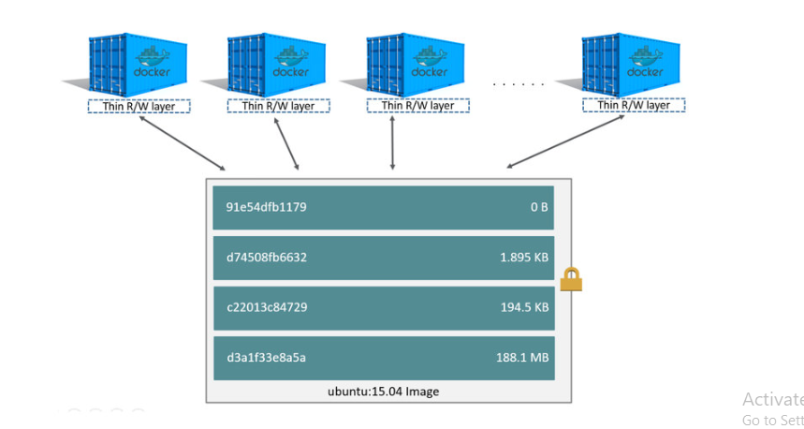
Multiple Containers sharing the same image

Slide 17
Wait a minute…
If an image is read-only, how do we change it ????
We don’t..
We create a new container from that image
Then we make changes to that container
When we are satisfied with those changes, we transform them into a new layer
A new image is created by stacking the new layer on top of the old image

Slide 18
Idea is…
Only way to create an image is by FREEZING a container
Only way to create a container is by instantiating an image.

Slide 19
The Plan…
Create a container (with docker run) using your base distro of your choice.
Run a bunch of commands to install and setup our software in the container.
Turn the container into the new image by using “docker commit”
Add tags to the image with “docker tag”

Slide 20
Setting up our Container
Docker run –it Ubuntu
You will be inside the container now
Run this command “apt-get update –y” to refresh the list of packages available to install
Then run the command “apt-get install figlet”
Now exit the container
Now type “docker commit <your containerid> <newimageid>
Now the new image has been created. Let’s test it
Docker run –it <newimageid>

Slide 21
Let’s launch a webserver
docker container run -d --name webserver --publish 80:8080 awssameerzulfi/dockerciwebsite
Access it using aws instance publicip with the 80 port
i.e., PUBLICIP:80
Now stop the container and see whether you are able to access the same site or not .
What do you understand now ?????
Can you launch one more container with different ports like this
docker container run -d --name webserver --publish 81:8080 awssameerzulfi/dockerciwebsite
Try to access the site in browser publicipoftheawsinstance:81
What do you get???

Slide 22
How To Tidy things up
docker container rm $(docker container ls -aq) -f

